Slide 1

Rent or Airbnb?
Terry Kim
Brian Yang
Abhi Nathan
David Jeong
Aishwarya Bhupatiraju

Slide 2




MOTIVATION
The Problem
Goal: To provide homeowners the information they need to make smarter financial decisions about renting out their house.
VS.
Should homeowners use Airbnb or more traditional rental methods?
MOTIVATION
DATA
ANALYSIS
IMPACT
NEXT STEPS
Notes:
Problem -> With the rise of Airbnb, homeowners are faced with multiple options when deciding how to rent their place
Solution: Basing it off of price which one is better -> price per day

Slide 3
DATA
Collection and Process
Airbnb Data
Rental Data
Geography: San Francisco
Source: “Inside Airbnb Adding Data to the Debate”
Description: Contains all possible details about the establishment and the host.
Geography: US
Source: Rental Listing Data from Zillow
Description: Combined median rental listing data for studio apartments, one bedrooms, two bedrooms, three bedrooms, four bedrooms, and five bedrooms.
Merged Data
We selected specific features for the model after determining which columns were significant.
MOTIVATION
DATA
ANALYSIS
IMPACT
NEXT STEPS
Notes:
The rental data covers the whole United states, but by inner joining to the airbnb data, all of the irrelevant data (non sf) got dropped. We also cleaned the data by using z scores, getting rid of all the rows that had a z score higher than 3.
We dropped outliers from our data.

Slide 4

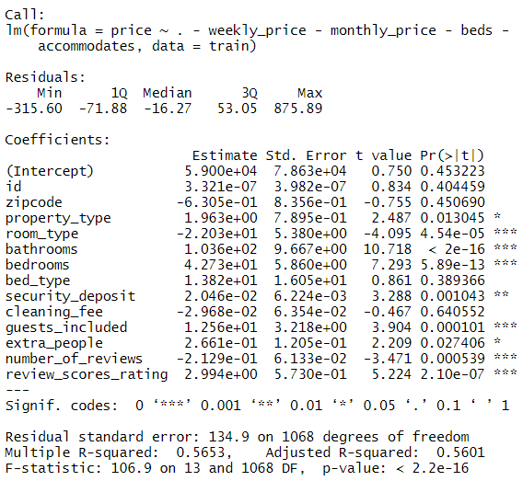
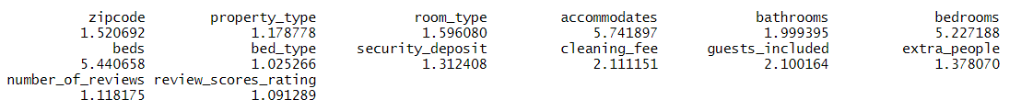
ANALYTICS MODEL #1
Linear Regression Model
Key Metrics
Summary Statistics
OSR² = 0.6388653
RMSE = 120.1169
MAE = 74.02877
Multicollinearity
MOTIVATION
DATA
ANALYSIS
IMPACT
NEXT STEPS
Notes:
After we ran our linear regression model, we checked the vif of each variable to see if there was any multicollinearity within them. We noticed that bedrooms ,beds, and accommodates had very similar values of vif around 5 so we decided to remove beds from our features.

Slide 5
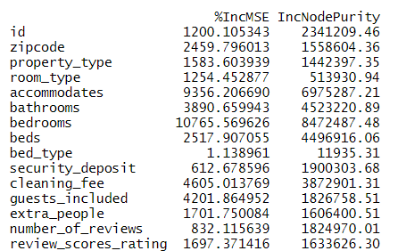
ANALYTICS MODEL #2
Random Forest Model
Key Metrics
Summary Statistics
OSR² = 0.6388653
RMSE = 120.1169
MAE = 74.02877
MOTIVATION
DATA
ANALYSIS
IMPACT
NEXT STEPS
Notes:
Ran random forest model
Had those results on the test set
Summary for random forest does not work well but this is the output
The output is the feature importance provided by the rf model.
IncMSE is analogous to accuracy-based importance.
IncNodePurity is analogous to Gini-based importance meaning that higher numbers refer to a higher importance.

Slide 6
IMPACT
Potential Impact and Future Expansion
Impact
Expansion
Provide homeowners the price per night their home would go for if they became an Airbnb host.
Provide homeowners the price per month their home would go for if they rented it out.
Help homeowners make more informed decisions with their real estate - a large investment.
We could potentially expand to more real estate options (i.e. leasing office buildings, etc.).
We could potentially expand to more rental options (i.e. Craigslist).
Although we believe finances are the biggest factor in choosing how to rent one’s home, there are definitely other factors we could take into account in future iterations of our analysis.
MOTIVATION
DATA
ANALYSIS
IMPACT
NEXT STEPS

Slide 7




NEXT STEPS
Future Work
Feature Engineering
Feature Selection
Hyperparameter Tuning
More
Models
MOTIVATION
DATA
ANALYSIS
IMPACT
NEXT STEPS

